Slide 1
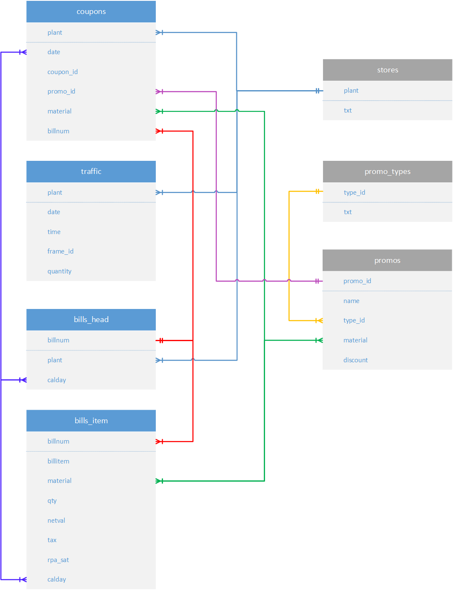
Факты
Словари

Slide 2
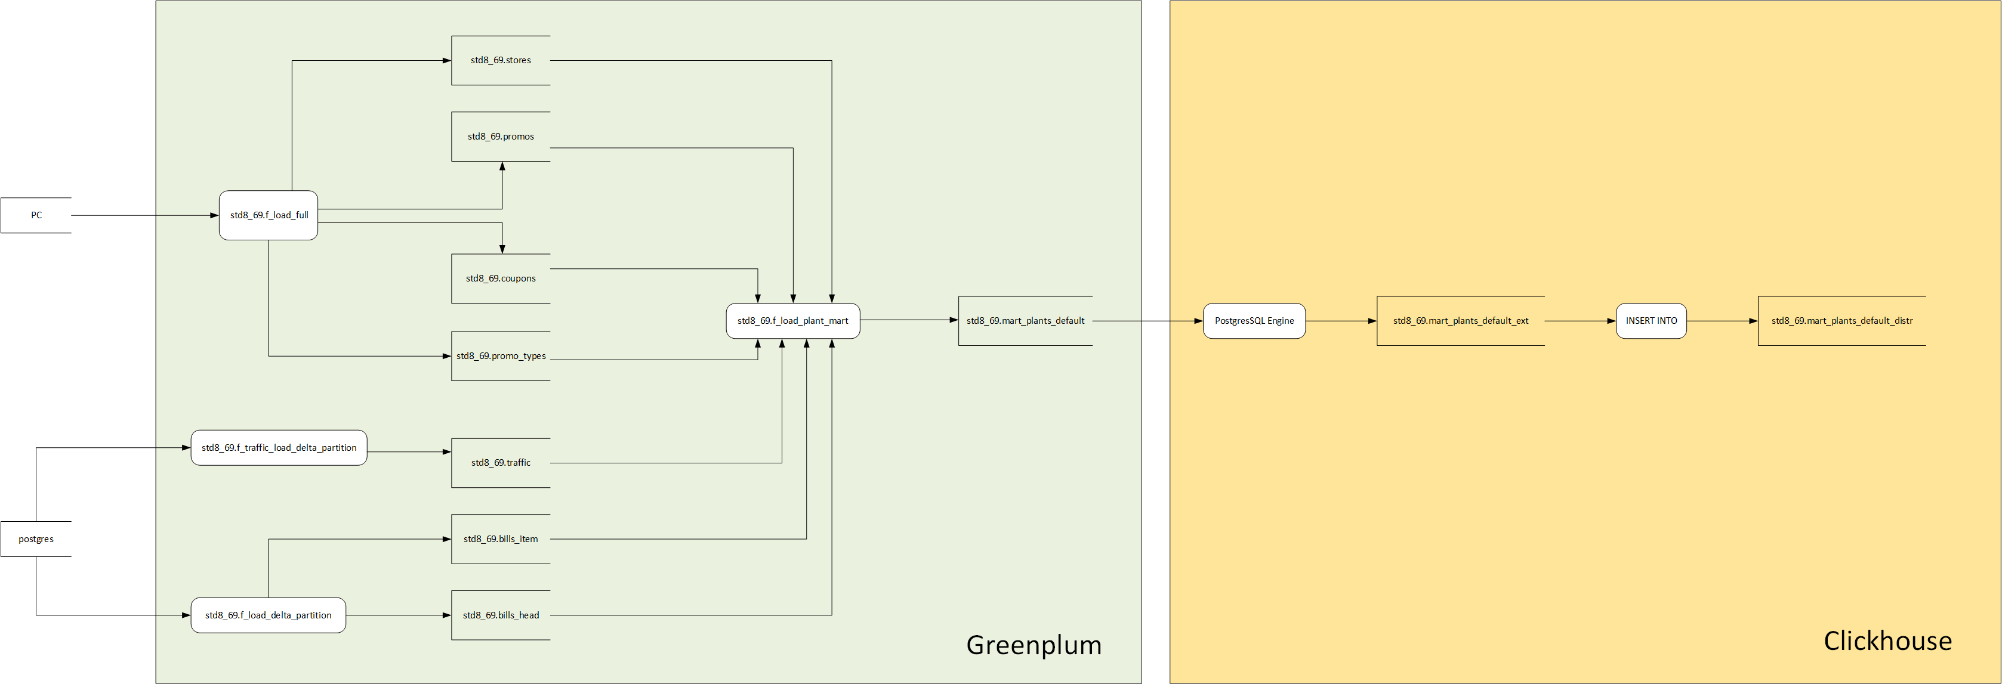

Slide 4
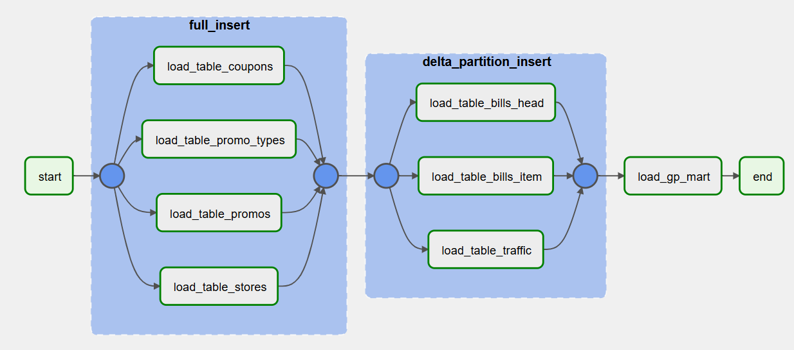

Slide 5
Mart loading in Greenplum
Параметры таблицы
Информация о продажах без вычета скидок
Число продаж
Число чеков
v_sql = 'CREATE TABLE ' || v_table_name || '
WITH
(
appendonly = true,
orientation = row,
compresstype = zstd,
compresslevel = 1
)
AS
WITH
-- gross sales:
-- total amount of money with no withdraw of discount yet
-- total amount of products sold
-- count of distinct bills
ct_gs AS
(
SELECT
bh.plant,
SUM(bi.rpa_sat) AS revenue,
SUM(bi.qty) AS quantity,
COUNT(DISTINCT bh.billnum) AS bills_count
FROM
std8_69.bills_head bh
JOIN
std8_69.bills_item bi ON bi.billnum = bh.billnum
WHERE bh.calday BETWEEN ''' || p_start || '''::date AND ''' || p_end || '''::date
GROUP BY bh.plant
),

Slide 6
-- promo totals
-- total amount of discount to be held from gross sales
ct_pt AS
(
SELECT
f_p.plant AS plant,
SUM(
CASE
WHEN f_p.type_id = ''001'' THEN f_p.discount
-- only 1 product can be used to apply coupon
-- so, we divide by their number to calculate the discount
WHEN f_p.type_id = ''002'' THEN f_p.rpa_sat::numeric / f_p.qty * (f_p.discount / 100.0)
ELSE 0::NUMERIC
END
) AS discount
FROM
(
-- DISTINCT ON gets the 1st row partitioned by coupon_id
-- which is the same as giving discount only for the 1st product in the bill
SELECT DISTINCT ON(c.coupon_id)
c.plant, p.type_id, p.discount, bi.rpa_sat, bi.qty
FROM
std8_69.coupons c
JOIN std8_69.bills_item bi
ON bi.billnum = c.billnum AND bi.material = c.material
JOIN
std8_69.bills_head bh ON bh.plant = c.plant AND bh.billnum = bi.billnum
JOIN
std8_69.promos p ON p.promo_id = c.promo_id AND p.material = c.material
WHERE bh.calday BETWEEN ''' || p_start || '''::date AND ''' || p_end || '''::date
-- get the first row with the lowest billitem
-- according to the description of coupons table
ORDER BY c.coupon_id, bi.billitem
) AS f_p
GROUP BY f_p.plant
ORDER BY f_p.plant
),
Сумма вычета по скидке
Найти первые товары в чеке, подлежащие купону

Slide 7
Траффик
Число товаров, проданных с купоном
-- traffic
-- volume of traffic
ct_t AS
(
SELECT t.plant, SUM(t.quantity) AS traffic
FROM std8_69.traffic t
WHERE t."date" BETWEEN ''' || p_start || '''::date AND ''' || p_end || '''::date
GROUP BY t.plant
),
-- products with coupons
-- number of products with coupons
ct_c AS
(
SELECT c.plant, COUNT(1) AS quantity
FROM std8_69.coupons c
WHERE c."date" BETWEEN ''' || p_start || '''::date AND ''' || p_end || '''::date
GROUP BY c.plant
)

Slide 8
-- wrap it all up
SELECT
-- "Завод (Текст)
s.plant,
-- "Завод" (Текст)
s.txt,
-- Оборот
ct_gs.revenue,
-- Скидки по купонам
ct_pt.discount,
-- Оборот с учетом скидки
(ct_gs.revenue - ct_pt.discount) AS profit,
-- кол-во проданных товаров
ct_gs.quantity,
-- Количество чеков
ct_gs.bills_count,
-- Трафик
ct_t.traffic,
-- Кол-во товаров по акции
ct_c.quantity AS promo_sold,
-- Доля товаров со скидкой
ROUND(CASE WHEN ct_gs.quantity = 0 THEN 0 ELSE ct_c.quantity / ct_gs.quantity::numeric * 100.0 END, 1) AS promo_rate,
-- Среднее количество товаров в чеке
ROUND(CASE WHEN ct_gs.bills_count = 0 THEN 0 ELSE ct_gs.quantity / ct_gs.bills_count::numeric END, 2) AS avg_qty_per_bill,
-- Коэффициент конверсии магазина, %
ROUND(CASE WHEN ct_t.traffic = 0 THEN 0 ELSE ct_gs.bills_count / ct_t.traffic::numeric * 100.0 END, 2) AS btt,
-- Средний чек, руб
ROUND(CASE WHEN ct_gs.bills_count = 0 THEN 0 ELSE ct_gs.revenue / ct_gs.bills_count::numeric END, 1) AS avg_bill_rub,
-- Средняя выручка на одного посетителя, руб
ROUND(CASE WHEN ct_t.traffic = 0 THEN 0 ELSE ct_gs.revenue / ct_t.traffic::numeric END, 1) AS avg_customer_rub
FROM std8_69.stores s
JOIN ct_gs ON ct_gs.plant = s.plant
JOIN ct_pt ON ct_pt.plant = s.plant
JOIN ct_t ON ct_t.plant = s.plant
JOIN ct_c ON ct_c.plant = s.plant
ORDER BY s.plant
';
Параметры таблицы
Информация о продажах без вычета скидок
Число продаж Число чеков
Проверка знаменателя – удобно для формирования ежедневного отчета

Slide 9
Распределение витрины ch.mart_plants_default_final на кластере default_cluster
Replica #1
Replica #2
Shard #1
192.168.214.208
192.168.214.209
ch.mart_plants_default_final_distr
Shard #2
192.168.214.210
192.168.214.211

Slide 10
Загрузка данных в витрину Clickhouse
INSERT INTO std8_69.mart_plants_default_final_distr
SELECT *
FROM std8_69.mart_plants_default_ext;

Slide 11
